Slide 1
Next-Level Skills for Early Childhood Educators
Session 2: Integrating Literacy
Notes:
V2: December 7, 2022

Slide 2

Discussion
What does literacy mean to you?
What are the different kinds/types of literacy?
Notes:
Group discussion
Can make a list of the different kinds/types of literacy

Slide 3
Different types of literacy
Financial Literacy
Digital Literacy
Media Literacy
Cultural Literacy
Scientific Literacy
Informational Literacy
Physical Literacy
http://www.youtube.com/watch?v=RJyEEuy8xO4
http://www.youtube.com/watch?v=-sxcCIPm-rU
Notes:
Show the videos then discuss
See handout: types of literacy (for facilitator notes)

Slide 4

Learning Language and Loving It (p 323)
Children learn literacy from birth, and they learn about it much the same way as they learn about spoken language.
In natural, day-to-day interactions, children see their caregivers use print in meaningful ways – and they discover that those marks on paper actually mean something. Once they discover that print communicates, they want to know how.
As a teacher, you play a critical role in helping children develop the attitudes, skills and knowledge that lead to literacy.
Children develop reading and writing skills as they participate and communicate about real life, meaningful literacy events.
Notes:
Learning Language and Loving It is a Hanen Program for Early Childhood Educators
If you wanted, you could include other literacy and language programs that are available to ECE’s; these can be found online

Slide 5


Statistics
Literacy: Why it Matters http://www.communityliteracyofontario.ca/ literacy-why-it-matters/
2000 Words http://www.2000wordstogrow.ca/
What are some of the reasons that children’s literacy levels vary?
Notes:
Handout: More Than Words Can Say
Discussion – different reasons that children’s literacy levels vary

Slide 6

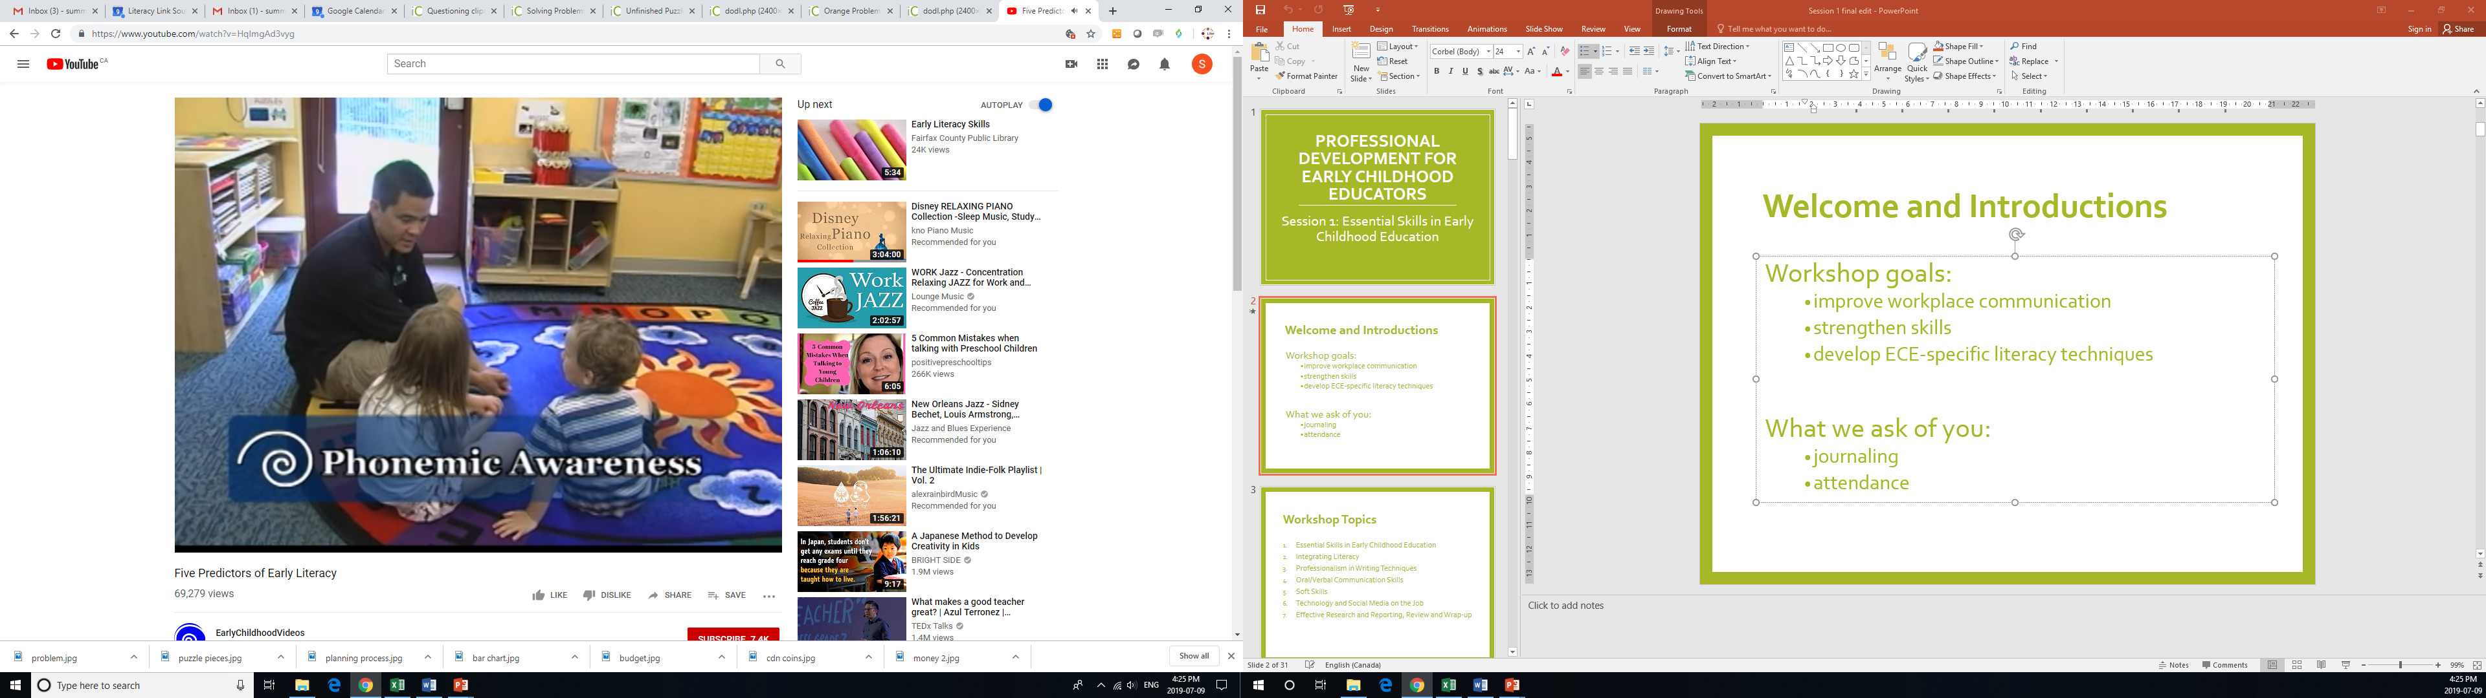
Video Clip
Five Predictors of Early Literacy
http://www.youtube.com/watch?v=HqImgAd3vyg
Notes:
Show the video then discuss

Slide 7

7 Components of Literacy
Increased vocabulary and language
Phonological awareness
Knowledge of print
Letters and words
Comprehension
Understanding books and other texts
Literacy as a source of enjoyment
How do these components link back to “Literacy: Why it Matters”?
Notes:
Please see document from The Creative Curriculum for Preschool, pages 126 to 131; it gives you the information to share for each of the seven components

Slide 8
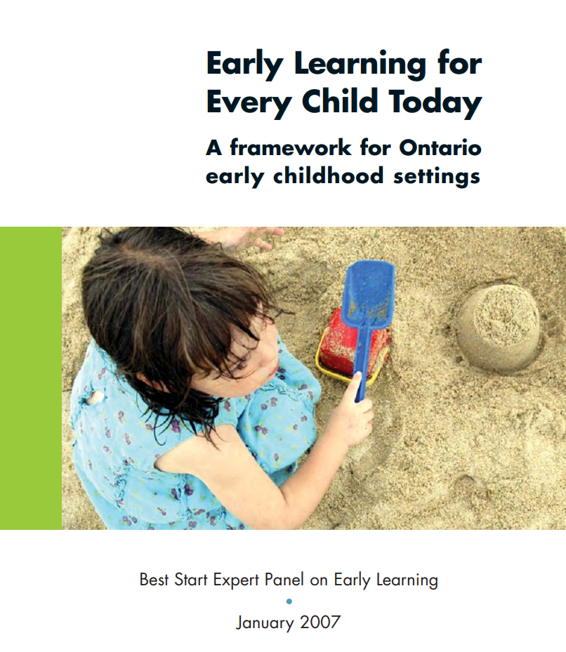
Literacy Development in Children
Early Learning for Every Child Today (ELECT) outlines the development of Communication, Language and Literacy in:
  Infants (birth to 24 months)
  Toddlers (14 months to 3 years)
  Preschool Kindergarten (2.5 to 6 years)
  School-Age children (5 to 8 years)
http://betterbeginningssudbury.ca/wp-content/uploads/2015/09/continuum.pdf
Notes:
Small group activity:
Split into 4 small groups
Have each group take a section listed on the slide (infant, toddler, preschool and school age), have them discuss and summarize the section to share with the larger group

Slide 9
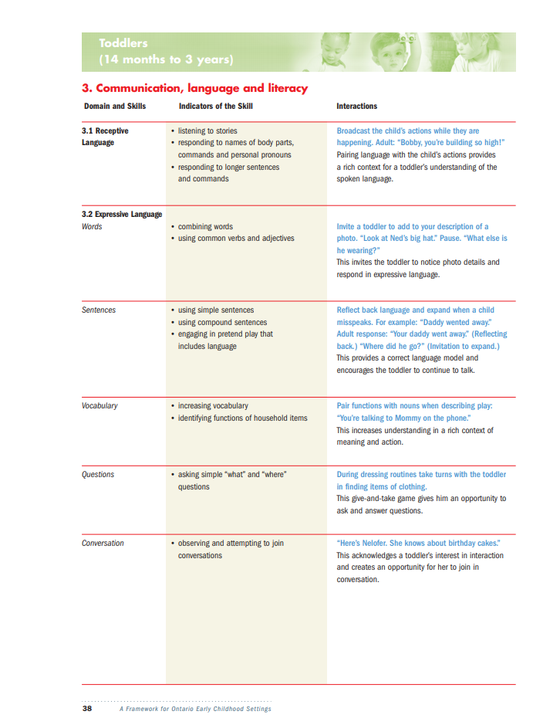
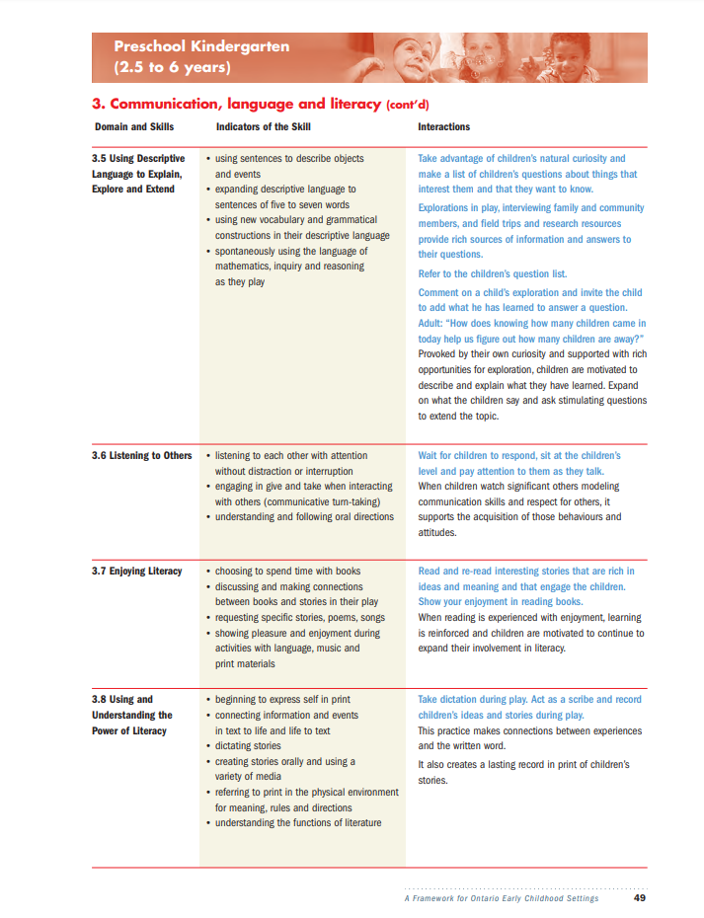
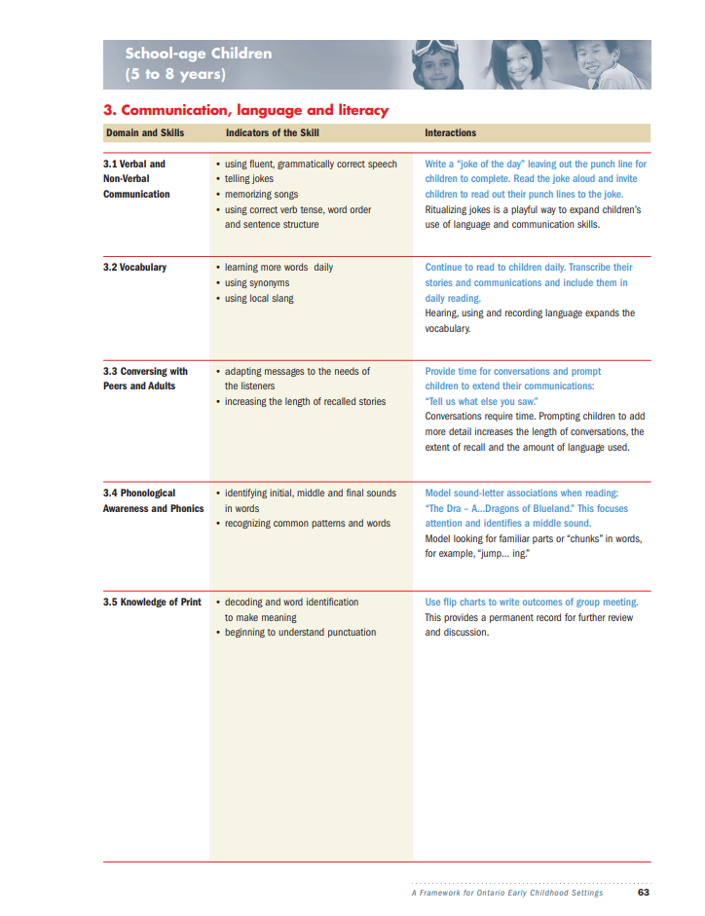
Activity: Identifying Literacy Skills
In small groups, use the ELECT document and choose an age grouping (infant, toddler, preschool or school age).
Discuss and identify the literacy skills that are developing for the age group
Summarize and share with the larger group

Slide 10
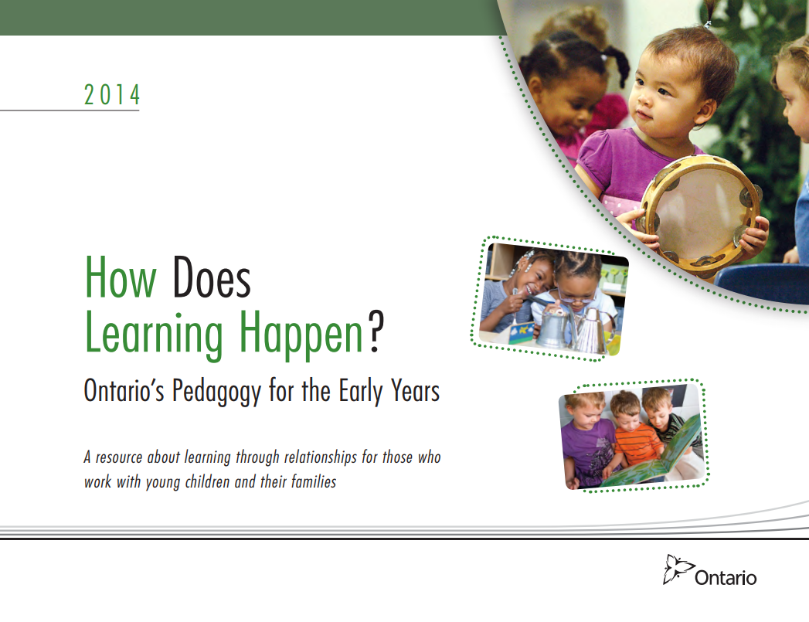
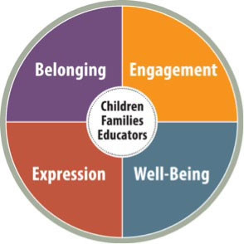
How Does Learning Happen?
Organized around four foundational conditions that are important for children to grow and flourish:
Belonging
Well-Being
Engagement
Expression
https://files.ontario.ca/edu-how-does-learning-happen-en-2021-03-23.pdf
Notes:
Discuss the Expression foundation and how the literacy skills included on the previous slides connect

Slide 11
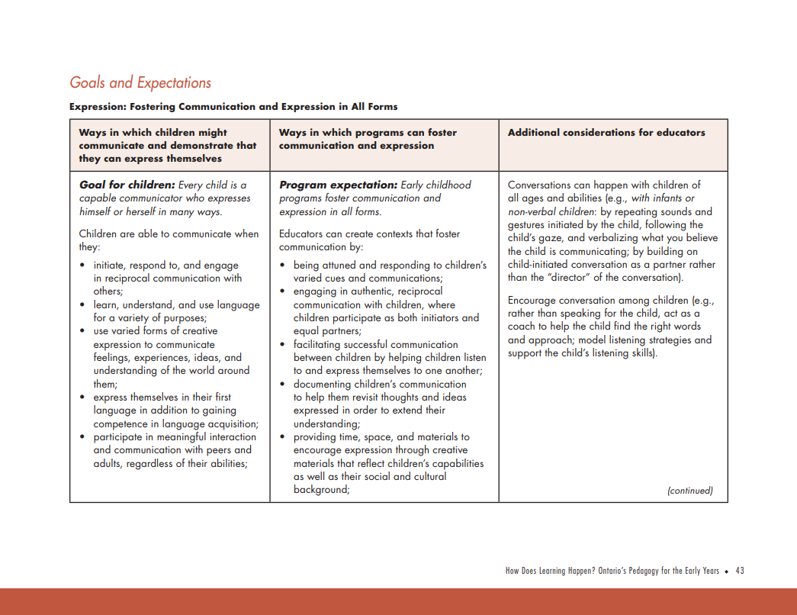
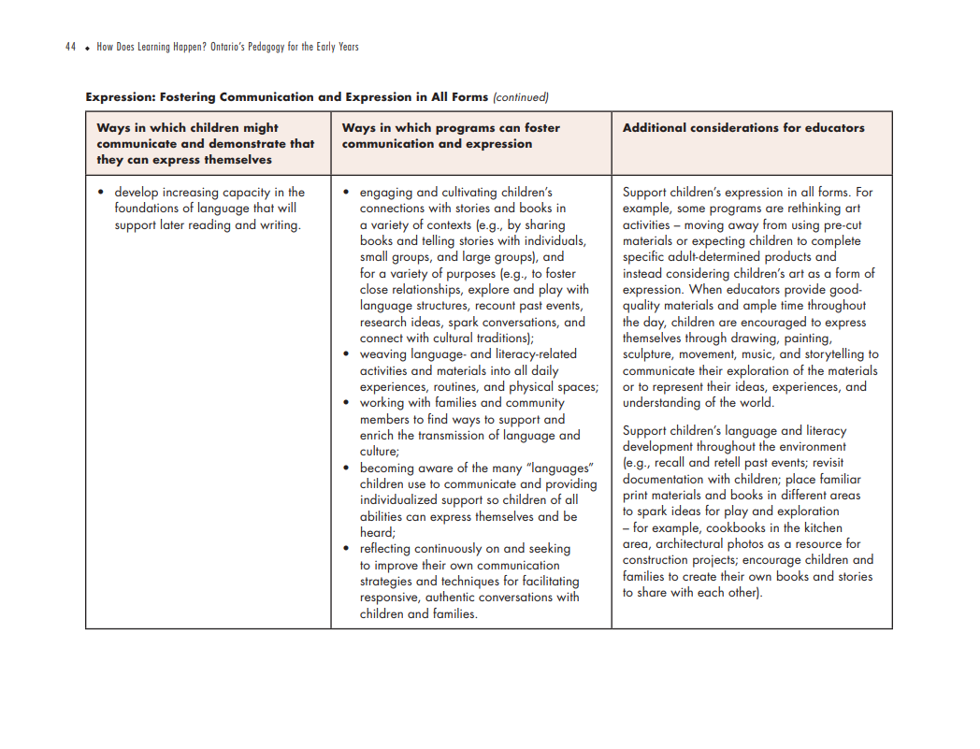
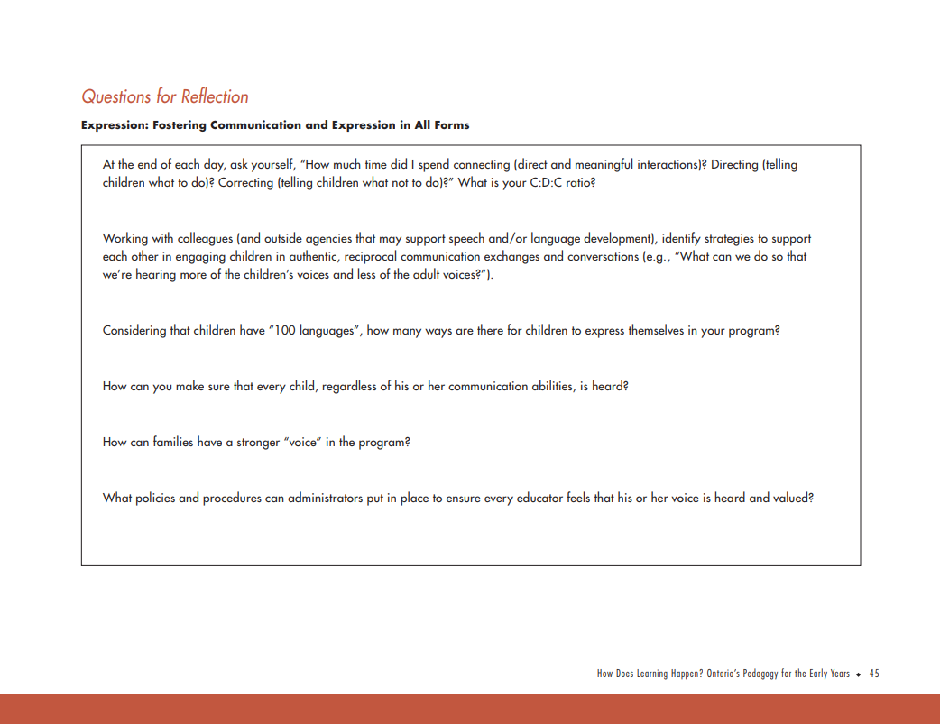
Activity: How Does Learning Happen?
Reflecting on the previous activity, connect the literacy skills your group discussed with the Expression foundation outlined in “How Does Learning Happen.”
Question: How many ways are there for children to express themselves in your program?
Notes:
Look at the Questions for Reflection at the end of the Expression section (p. 45 in the HDLH document) and use those directly or to develop a couple of discussion questions for the group

Slide 12
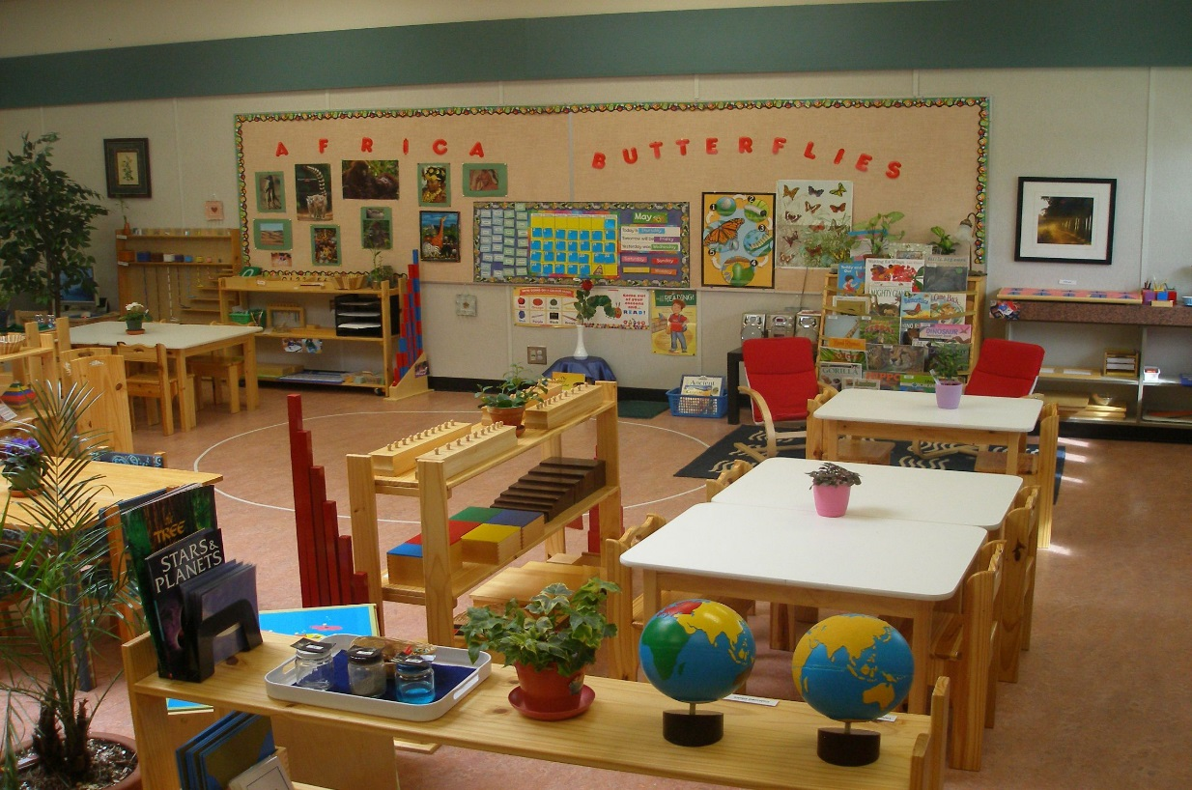
Examples of Literacy in the Classroom
How do you incorporate literacy into your classroom?
Notes:
Show pictures of examples of literacy in classrooms; there is a document with pictures that can be printed out and made into a photo album; you can add your own pictures to it

Slide 13


Activity: Reading Stories
  In small groups, reflect on what you saw in the videos, and discuss the following questions:
  What different strategies were used?
  What do you do when you read a story to children?
  Is there anything you find you struggle with?
  What other storytelling strategies would you like to integrate into your program?
  Optional: read your book to your small group to practice!
https://www.youtube.com/watch?v=m9zcjgm2hXY
https://www.youtube.com/watch?v=6E67n1vZZjQ
Notes:
Show a video of someone reading a story (there are two imbedded or you can include one of your own)
Have the students split into small groups and discuss the question on the slide; they have the option to read the book aloud to the group
You can also prepare your own favourite story to read for the group and show how it has been integrated into a program
Also see the document that has been started with pictures of story tables

Slide 14

Journal Reflection
How are you currently integrating literacy in your work? What are you already doing?
Think of ways you can take what you learned and add it to your programming. What else can you be doing?
What can you do differently?

Slide 15

Next Session
Bring in some of the different documents that you use at work
Bring in your Reflection Journal
Notes:
Facilitator note: You do not need to advance to the next screen for the group – it is for identification purposes only.

Slide 16


Acknowledgements:
This presentation was designed in 2019 to support Ontario’s Early Childhood Educators in further developing the unique communication skills required in their role. It should be used with the accompanying Participant Workbook, and Reflection Journal.
Curriculum developed by: Carolyn Little and Helen Krygsman
Editing and design support by: Summer Burton
Support for this project was provided by:
Organizations are encouraged to copy and use these materials; however, reproducing or reselling these materials for profit is prohibited. If you have questions about this curriculum, we invite you to contact Literacy Link South Central at 519-681-7307 or literacylink@llsc.on.ca

Slide 17
Sources
Trister Dodge, D., Colker, L., Heroman, C. (2002). The Creative Curriculum for Preschool. Washington, DC: Teaching Strategies Inc.
Weitzman, E., Greenberg, J. (2002). Learning Language and Loving It. Toronto, ON: The Hanen Centre.
Early Learning for Every Child Today: A framework for Ontario early childhood settings. (2006). http://www.edu.gov.on.ca/childcare/oelf/continuum/continuum.pdf
How Does Learning Happen? Ontario’s Pedagogy for the Early Years. (2014). http://www.edu.gov.on.ca/childcare/howlearninghappens.pdf

